Slide 1
Using Influential Indicators to build a US SPDR Sector ETF trading model
Group 5:
Preeti Bekal
Wyatt Marciniak
Neel Shah

Slide 2
The Objective
Using classification methodology and supervised machine learning techniques, we aim to identify:
Prediction Models
To Accurately predict the direction (not magnitude) of Sector ETF price movements
On a Monthly frequency
This project also aims to conclude if the methods we use here can be used as a base asset allocation model
Sector ETFs can be used as a proxy for the US sectors
Estimating Price movements could help indicate which sectors are more prone to higher yielding investments (Future Project Development)

Slide 3
The Data
10 Sector ETFs (SPDR) vehicles for the 10 major sectors of the US economy:
Biotech, Consumer Discretionary/Staples, Energy, Finance, HealthCare, Industrials, Materials, technology, Utilities
US Treasury Rates:
1,2,3,5,7,10,30 years
Exchange Rates (Top comparable economies by Trade with the US):
Brazil, Canada, China, Japan, Mexico, South Korea, Switzerland, Eurozone
Market Indicators:
Gold Price, Oil, USD, VIX, Federal Funds rate, UM Sentiment Index, Home Price Index, Unemployment, BAC HY Bond Index, Auto-Sales

Slide 4
Mining and Cleaning the Data (Data Script)
Quantmod Package:
Utilize Yahoo Finance for Stock/ETF market data
Utilized FRED database for all economic and indicator data
Function Created: data_pull()
Format Data to be monthly returns
All data can be aligned by their monthly returns
Monthly returns is a more realistic trading period for ETFs and US sectors
Function Created: comp.data()
Output the data frames to be saved and accessed by our analysis scripts

Slide 5
Analysis of Data
Correlation Ranking by absolute value of relationship
Kmeans Clustering (relationship analysis tool):
Euclidean Distance (on returns)
Correlation Distance (based on returns)
Hierarchal Clustering (relationship analysis tool):
Euclidean Distance (on returns)
Correlation Distance (based on returns)
Multivariate Linear Regression Models (Prediction tool)
Decision Trees (Prediction tool)
Trading Strategy based on prediction signals (Back Testing results)

Slide 6
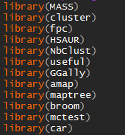
Current Packages
Clustering
Decision Trees
Linear Regression and Multicollinearity

Slide 7
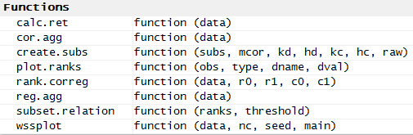
Current Functions

Slide 8
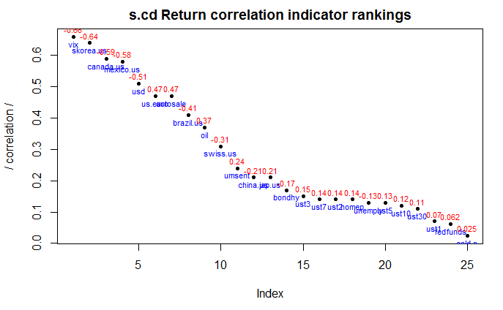
Analyzing Correlations for initial assessment
The Correlations are ranked by their absolute value per the target ETF
The plot shows the components, ranked and labeled with their name and actual correlation sign (positive or negative)
This serves as a visualize analysis of the variable relationships
Here we can create our first data subset by some corr. Threshold (>= 0.30)

Slide 9
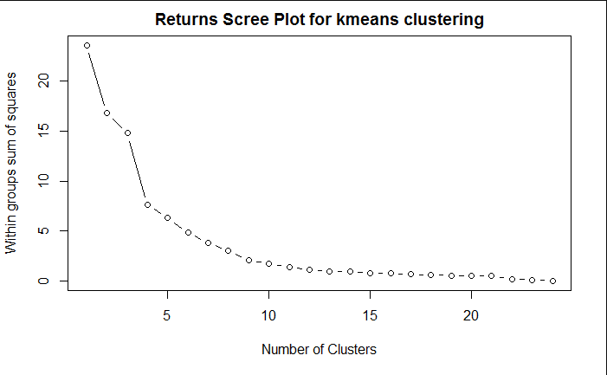
Kmeans Clustering Analysis (returns distance)
We first look at a Scree (“Elbow”) Plot to identify the ideal number of clusters.
The ideal number is where adding another clusters does very little to alter the amount of WSS
This point is referred to as the “elbow”
Here, we test k from 3 to 7

Slide 10
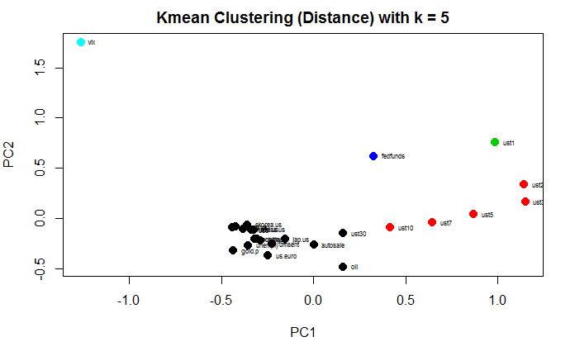
Best K selection
After Testing the possible Clusters, we have selected the best result to be 5 clusters.
This plot shows the indicator data clustered with 5 clusters and we can see reasonable groupings have been formed.
The next step was to extract the cluster assignment tags into a data frame to be used in the final sub-setting operation.

Slide 11
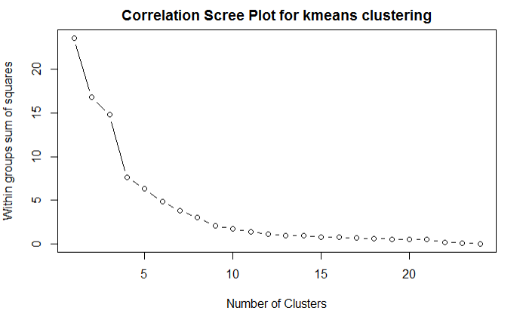
Kmeans Clustering Analysis (correlation distance)
For correlation clustering, we look at clustering the data based on distance correlation.
For Kmeans, we used a correlation matrix.
From the Scree plot, we extract our k’s to test
Here they are 4 - 8

Slide 12
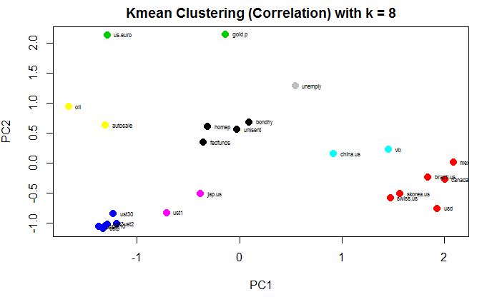
Best K selection
After testing, we identified the best number of clusters to be 8
Here we can see the clusters assigned and again we can see reasonable assignments.
These results are based on the behavior of correlation these variables have with one another.
We then save the cluster tags

Slide 13
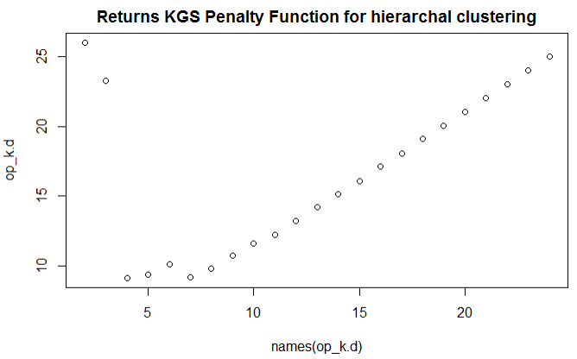
Hierarchal Clustering (returns distance)
For Hierarchal Clustering, once we have selected out methodology for clustering, the plot is created.
The crucial component here is again to select the ideal number of clusters (“pruning”) the tree.
We use the Kelley-Gardner-Sutcliffe penalty function and look for minimum values
Here we test 4-8 clusters

Slide 14
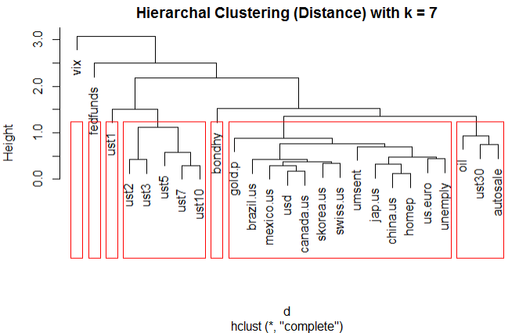
Best K selection
After testing we have selected 7 clusters
We can see, based on the height (order level) in which the nodes were combined, and by the number of nodes in each subgroup that this cluster amounts appears to be a good fit
We store these tags for future analysis.

Slide 15
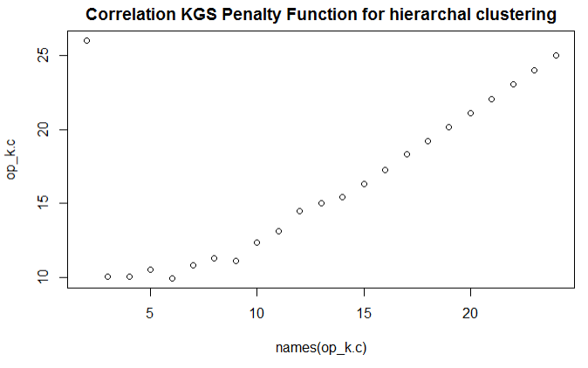

Hierarchal Clustering (correlation distance)
First, we note that this distance calculation is generate by a dissimilarity matrix based off of the correlation matrix:
Once the tree is built, we then again check the KGS plot for potential optimal cluster values to test.
Here, we test 3 – 9 clusters.

Slide 16
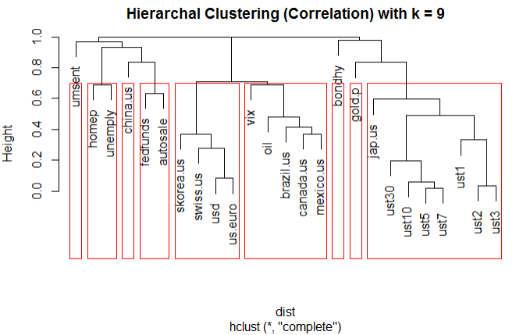
Best K selection
After testing, we identified 9 clusters to be an ideal classification.
We can see by the clusters and merging orders here that these clusters appear to be a good fit.
We have saved these tags for processing in the next step

Slide 17
Selecting key indicators
After getting the cluster selections from the 4 classification methods, we have built a function to create subset data sets for model testing and construction.
We are building 4 data sets (1 per method) for each target ETF to model.
We check the current list of parameters (abs(cor)>= 0.30) and check for parameters in the same clusters.
If they are alone, keep
If they are not, take the highest correlated component to the ETF and then keep any other whose correlation to that selected parameters are < 0.50
The goal here is to pre-emptively remove collinearity using clustering methodologies to group behaviors of the variables.
This function is almost complete and after his we can begin model testing.

Slide 18
Notes on our project so far
We are using only market indicators and rates as predictors, and not using other ETFs in an attempt utilize only market indicator information.
This methodology may change based on model testing accuracy
We see a higher number of clusters are appropriate for correlation testing than Euclidean distance testing for return data
We are building models for all 4 methods to test different classifications

Slide 19
Next Steps: Building and testing the models
The next steps:
Build Multi-variate regression models on the subset parameter lists
Compare them to step-wise regression models built on full data set
Build/Prune Desicion tree models on subset parameter lists
Compare them to full data-set tree training
Create a back testing function for trading based off these model predictions
Test holding the broad market (Sp500, DJIA)
Test holding the full basket of ETFS (Long only)
Test trading the ETFs monthly based on prediction model signals constructed
Compare results and make conclusions on viability of our strategy

Slide 20
Using Influential Indicators to build a US SPDR Sector ETF trading model
Group 5:
Preeti Bekal
Wyatt Marciniak
Neel Shah

